Slide 1

Generating n-bit gray code using backtracking approach
DEPARTMENT OF INFORMATION SCIENCE AND ENGINEERING
BANGALORE INSTITUTE OF TECHNOLOGY
Presented by:
NAME | USN
ROSHAN KUMAR | 1BI18IS065
YASH KUMAR ADARSH | 1BI18IS066
RITVIZ RANJAN | 1BI18IS067
Under the guidance of:
Prameela R
Asst. Professor
Dept. of ISE

Slide 2

What is backtracking approach?
It is an algorithmic-technique for solving problems recursively.
Solution is build incrementally, one piece at a time.
Solutions that fail to satisfy the constraints of the problem at any point of time are removed.
According to the wiki definition,
Backtracking can be defined as a general algorithmic technique that considers searching every possible combination in order to solve a computational problem.

Slide 3
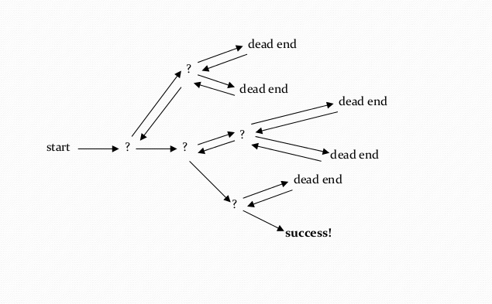
Backtracking approach in animation:
(Source: https://slideshare.net )

Slide 4
Types of problem in backtracking:
There are three types of problem in backtracking
Decision problem– In this, we search for a feasible solution.
Optimization problem– In this, we search for the best solution.
Enumeration problem– In this, we search for all feasible solution.

Slide 5
What is Gray Code?
It is an ordering of the binary numeral system.
Ordering is such that two successive values differ by only one bit (binary digit).
They are very useful in the normal sequence of binary numbers generated by the hardware that may cause an error or ambiguity during the transition from one number to the next.
Gray code eliminate this problem easily since only one bit changes its value during any transition between two numbers.
It is not weighted that means it does not depend on the positional value of digit
Also known as reflected binary code, because the first(n/2) values compare with those of the last(n/2) values, but in reverse order.

Slide 6
Generating n-bit gray code
For each bit out of n bit we have a choice either we can ignore it or we can invert the bit so this means our gray sequence goes upto 2 ^ n for n bits. So we make two recursive calls for either inverting the bit or leaving the bit as it is.
SOURCE CODE(JAVA):
// JAVA program to find the gray sequence of n bits.
import java.util.*;
class GFG
{
static int num;
/* we have 2 choices for each of the n bits either we
can include i.e invert the bit or we can exclude the
bit i.e we can leave the number as it is. */

Slide 7
static void grayCodeUtil(Vector<Integer> res, int n)
{
// base case when we run out bits to process
// we simply include it in gray code sequence.
if (n == 0)
{
res.add(num);
return;
}
// ignore the bit.
grayCodeUtil(res, n - 1);
// invert the bit.
num = num ^ (1 << (n - 1));
grayCodeUtil(res, n - 1);
}
// returns the vector containing the gray
// code sequence of n bits.

Slide 8
static Vector<Integer> grayCodes(int n)
{
Vector<Integer> res = new Vector<Integer>();
// num is passed by reference to keep
// track of current code.
num = 0;
grayCodeUtil(res, n);
return res;
}
// Driver function.
public static void main(String[] args)
{
int n = 3;
Vector<Integer> code = grayCodes(n);
for (int i = 0; i < code.size(); i++)
System.out.print(code.get(i) +"\n");
}
}

Slide 9
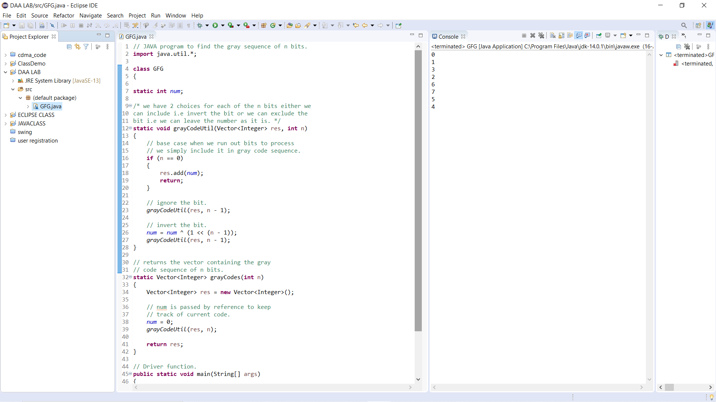
OUTPUT SNAPSHOT:

Slide 10
CONCLUSION:
In conclusion, three things on behalf of backtracking need to be said:-
It is typically applied to difficult combinatorial problems for which no efficient algorithm for finding, exact solutions possibly exist.
Backtracking solves each instances of a problem in an acceptable amount of time.
It generates all elements of the problem state.

Slide 11
References:
Introduction to Algorithms, Thomas H. Cormen, Charles E. Leiserson, Ronal L. Rivest, Clifford Stein.
Design and Analysis of Algorithms , S. Sridhar, Oxford (Higher Education).
https://geeksforgeeks.org

Slide 12
Thank-You

